Slide 1

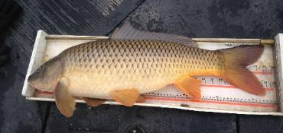
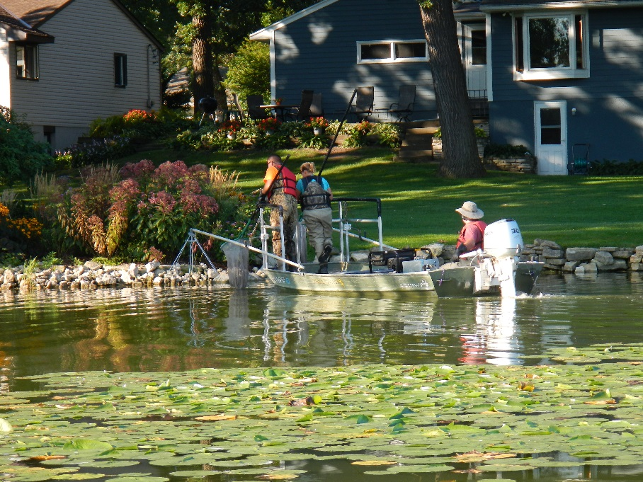
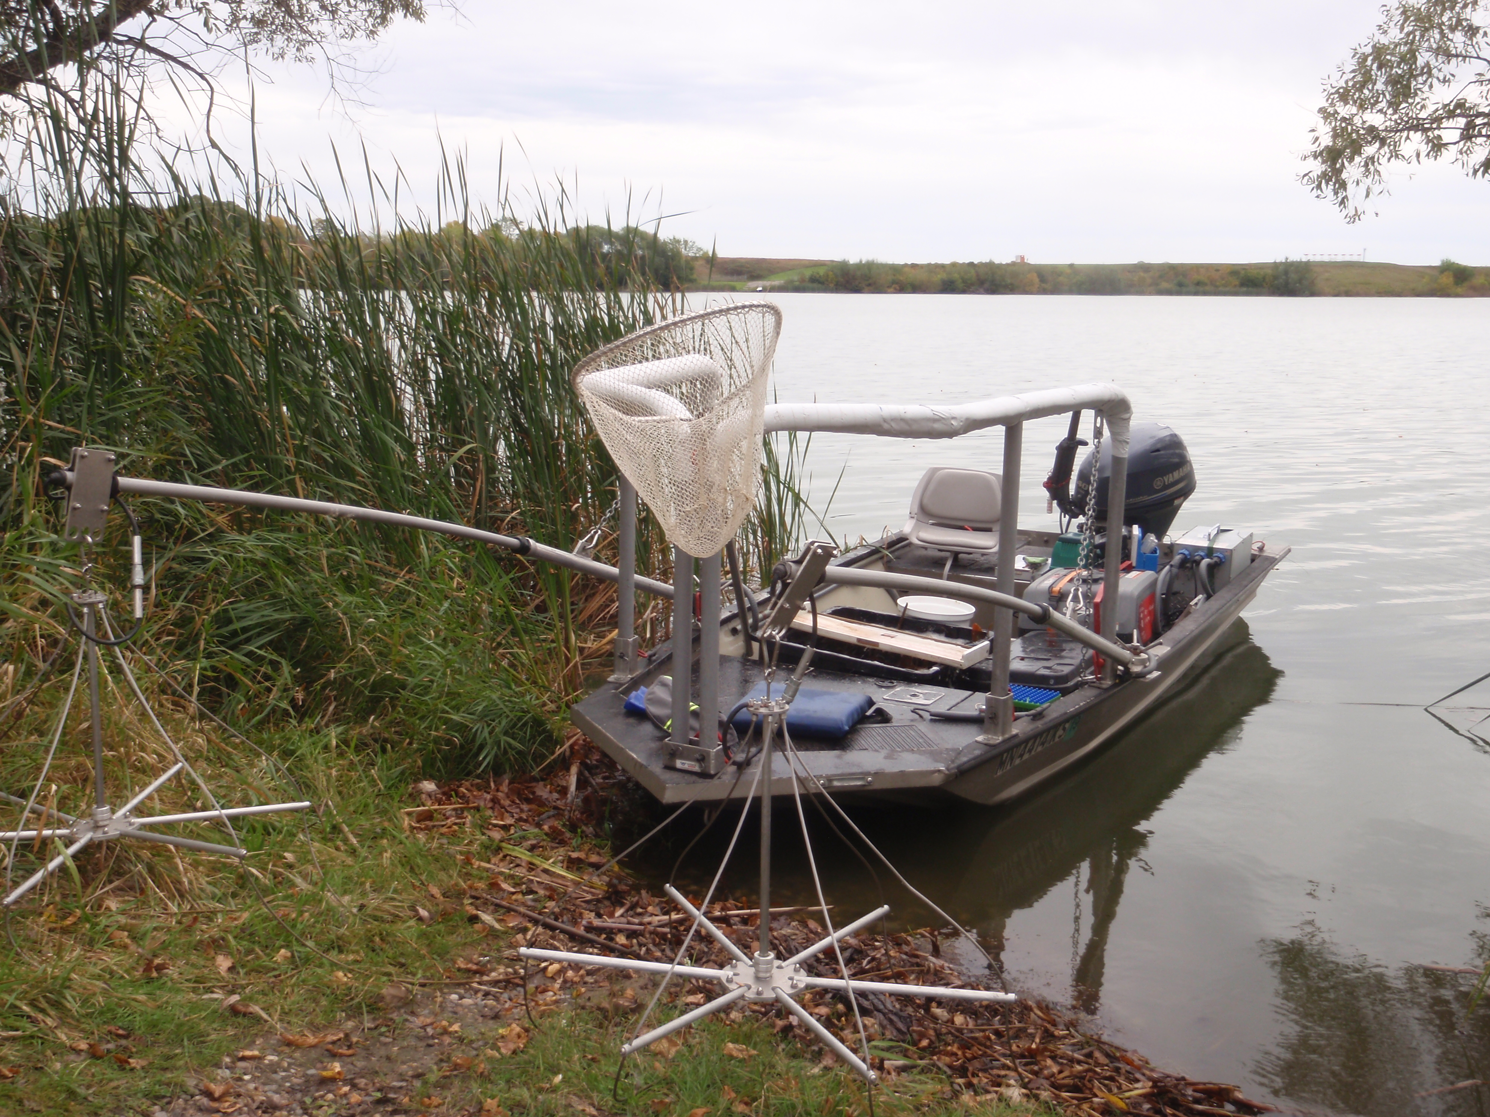

Le Sueur County Board Meeting
2019 Common Carp Assessments
Presented by
Aaron Claus
November 19th, 2019
Notes:
Add or deleted photos as needed. Delete “Presented by” text box if desired.
If title is long, stretch title box to the left

Slide 2
Agenda
What is the Common Carp?
Why Common Carp Management?
2019 Common Carp Population Assessments
Methods
Results from 11 lakes in Le Sueur county
Management Approach

Slide 3
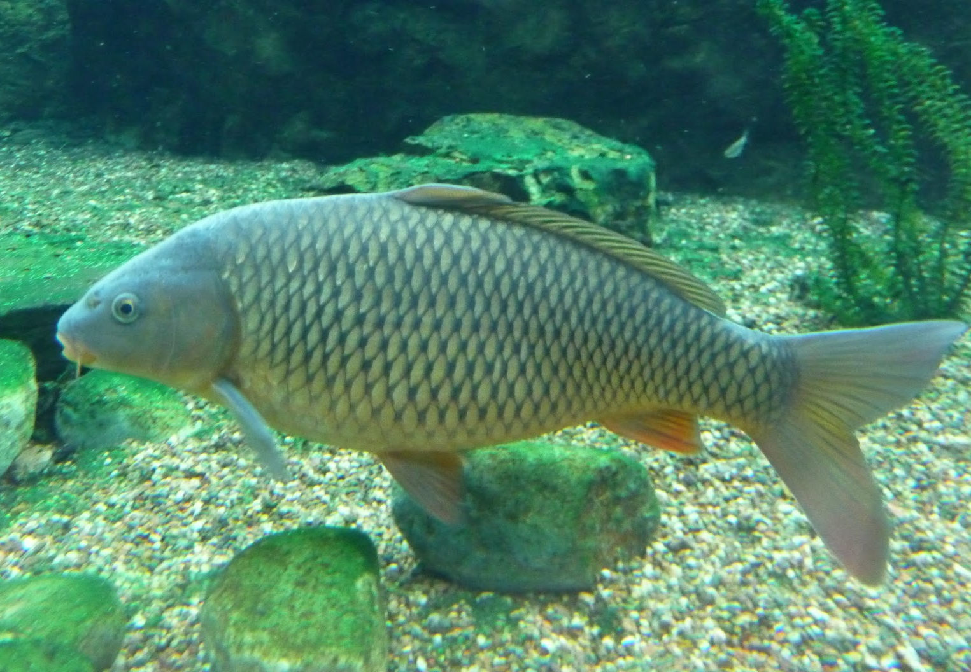
The Common Carp (Cyprinus carpio)

Slide 4
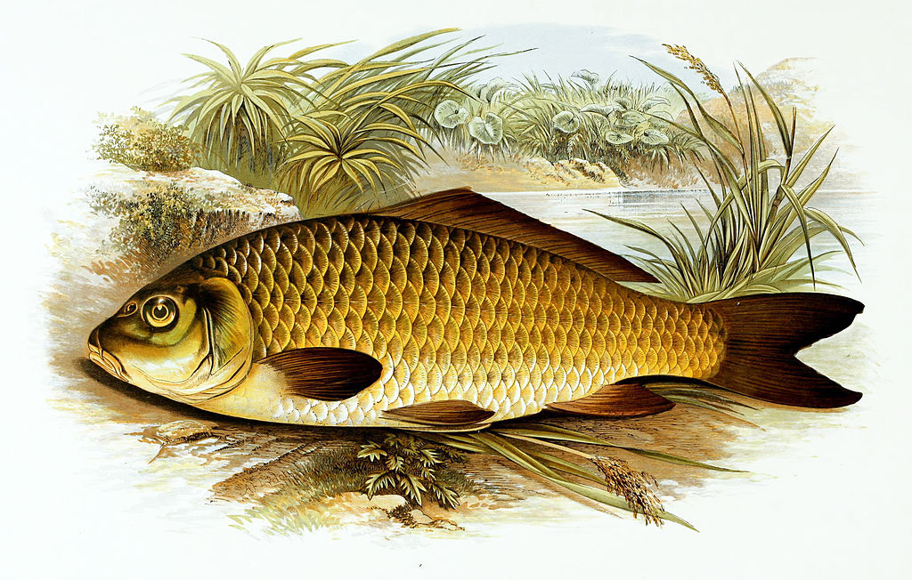
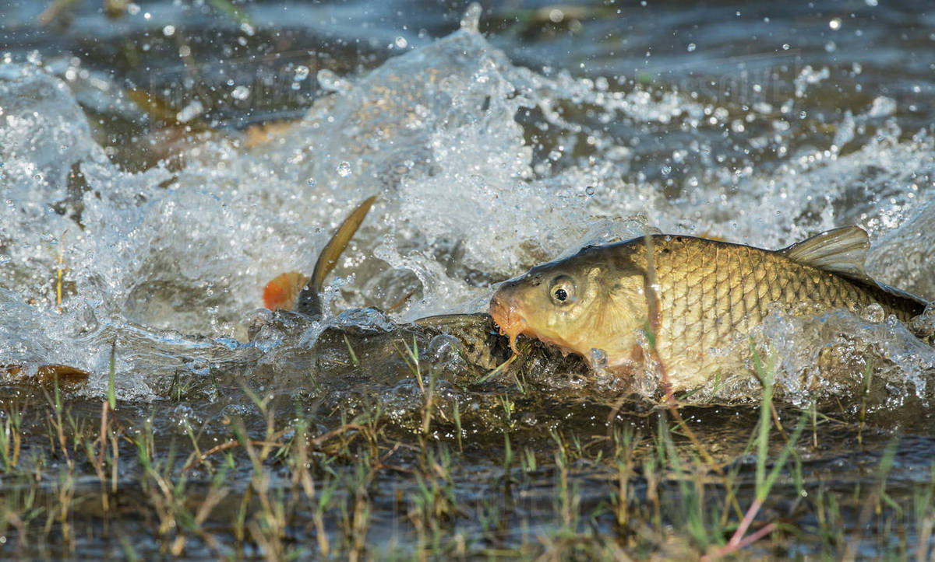
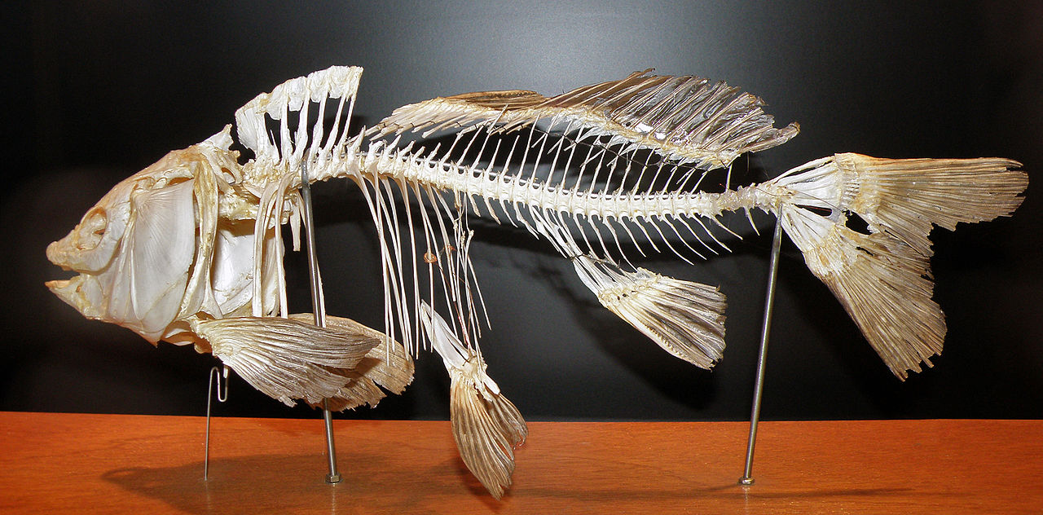
The Common Carp (Cyprinus carpio)
Large bodied minnow
Omnivorous bottom feeding specialist
“ecosystem engineer”
Partial migration and scramble spawning behavior
Widely domesticated and cultured
Native to Caspian Sea, introduced to U.S. in 1831

Slide 5
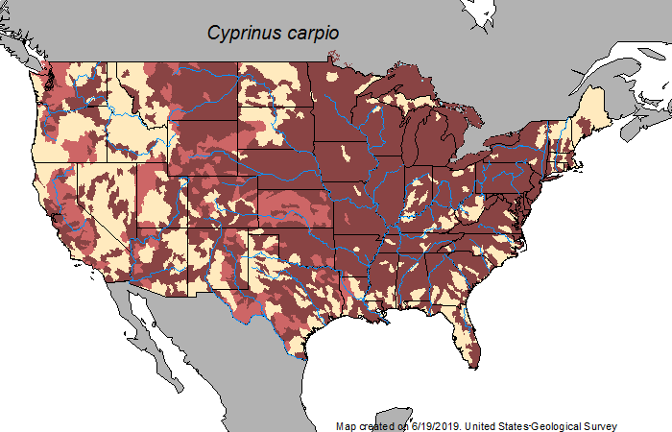
Effective Dispersal

Slide 6
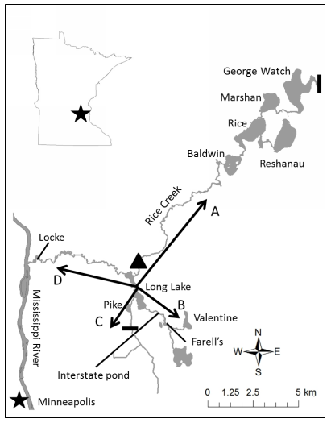
Long Range Spawning Migration
Nate Banet’ UMN M.Sc.
Partial migration behavior
Spring: shallow winterkill lakes
Summer: dispersed
Winter: deep lake
Why? Biocontrol
Watershed scale population function

Slide 7
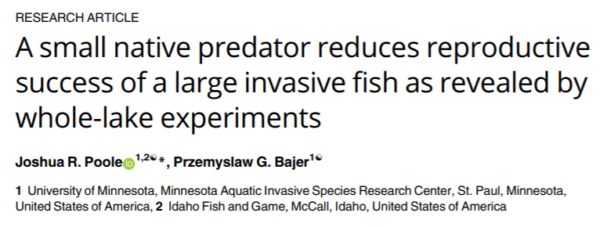
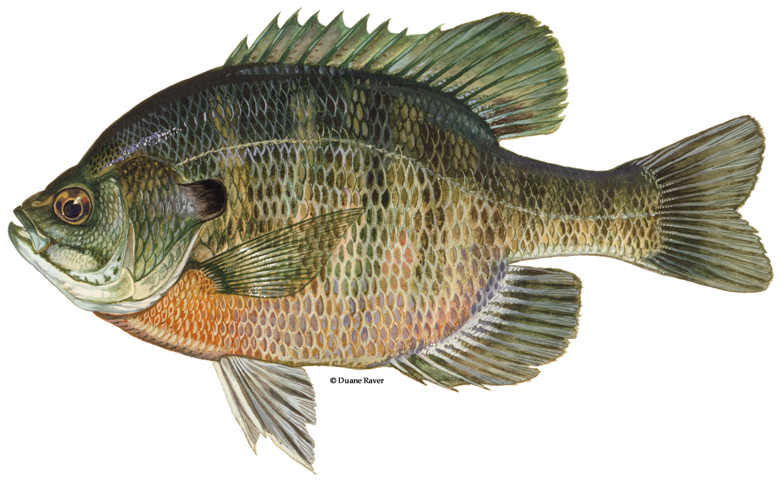
Biocontrol – Local Carp Populations

Slide 8
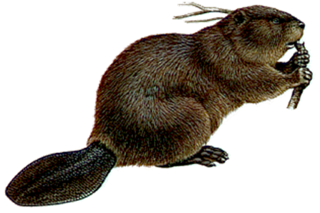
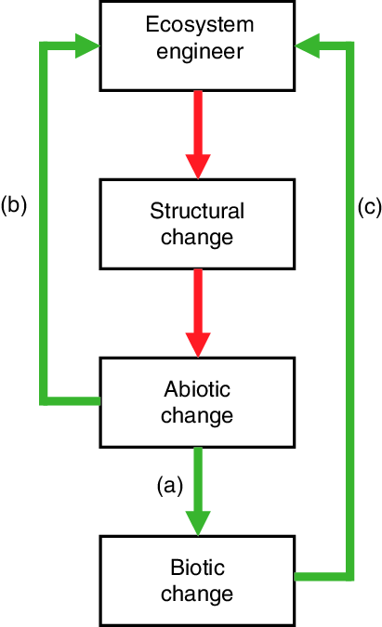
Ecosystem Engineer
Model: Beaver (Castor canadensis)
Significantly modifies habitat to its own benefit
Causes abiotic and then biotic change
High abundance causes large scale changes in:
Species richness
Landscape heterogeneity

Slide 9
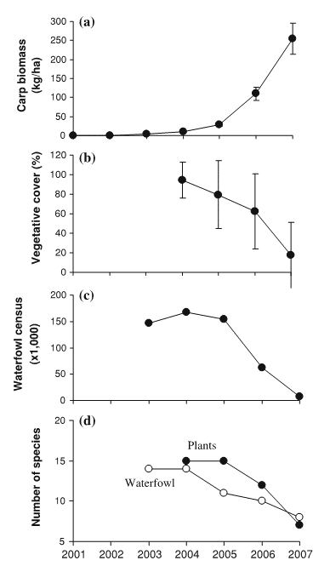
Common Carp – Why Manage
Excessive carp (>89 lbs/acre) in MN lakes can cause:
Increased sediment resuspension and internal nutrient loading
Increased turbidity (decreased clarity)
Decreased submerged vegetation
Degrades water quality, habitat, and diversity
Strongest effect in shallow lakes

Slide 10
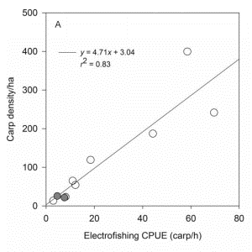
Management Approach
Is there an issue?
Initial Population Assessment
If so, exactly how severe is the issue?
Focused Population Assessment
How can the problem be mitigated?
Control Carp Reproduction
Adult Carp Removal
How can we prevent from reoccurring?
Maintenance management
Enhanced biocontrol
Holistic lake management

Slide 11
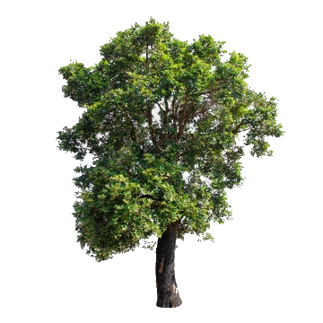
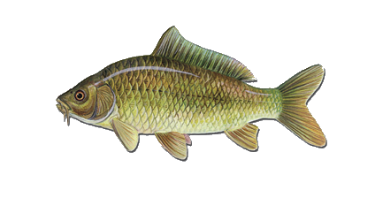
How Many Carp?
Assessing fish abundance is difficult
We can’t directly observe them
They move!
VS

Slide 12
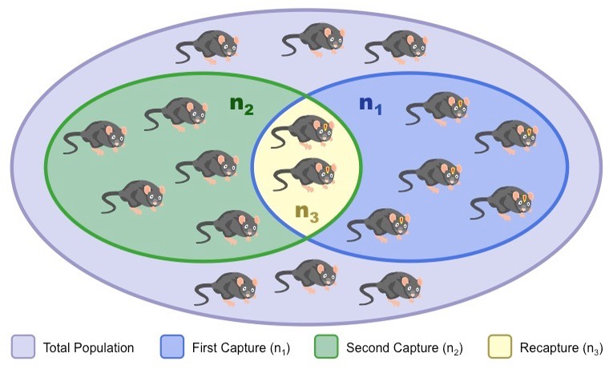
Capture-Mark-Recapture
Scientific gold standard method
Highest accuracy and precision
Requires significant effort
Marking and recapture efforts must be scaled to pop size
High relative cost

Slide 13

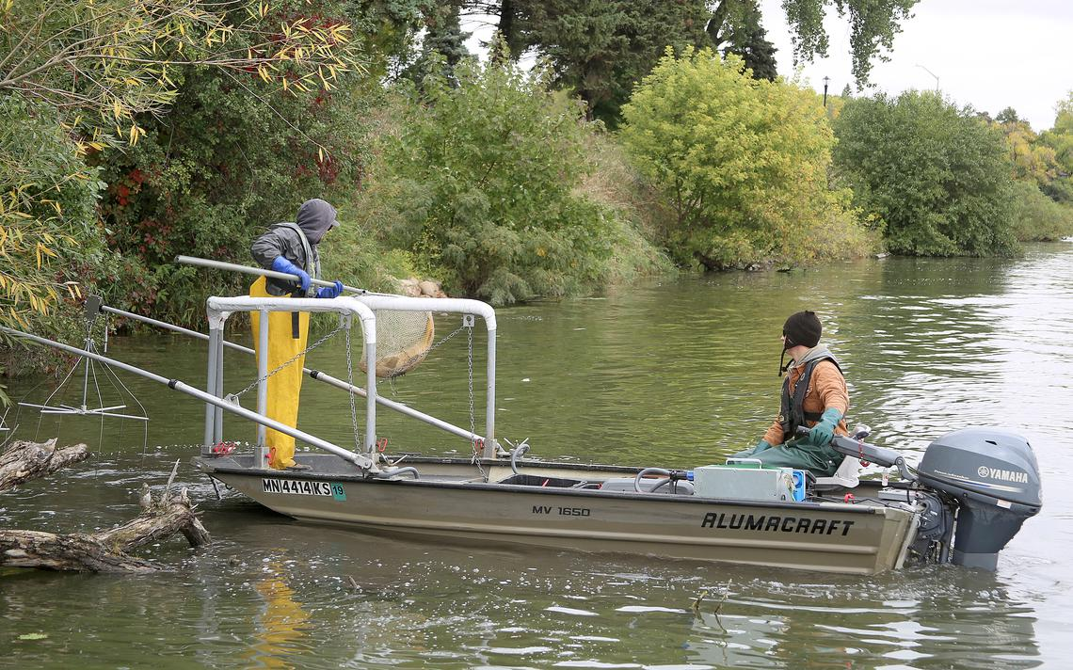
Rapid Carp Abundance Assessment
Boat Electrofishing
Stuns carp within electric field
Allows capture, data collection, tagging, and release
Catch per unit effort (Carp/hr)
Density calculated via model
Abundance calculated via density
Biomass density (lbs/acre)

Slide 14
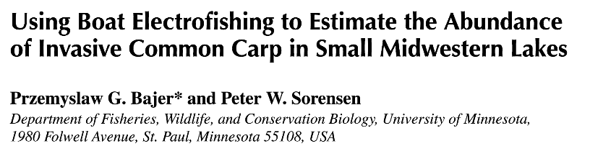

Slide 15
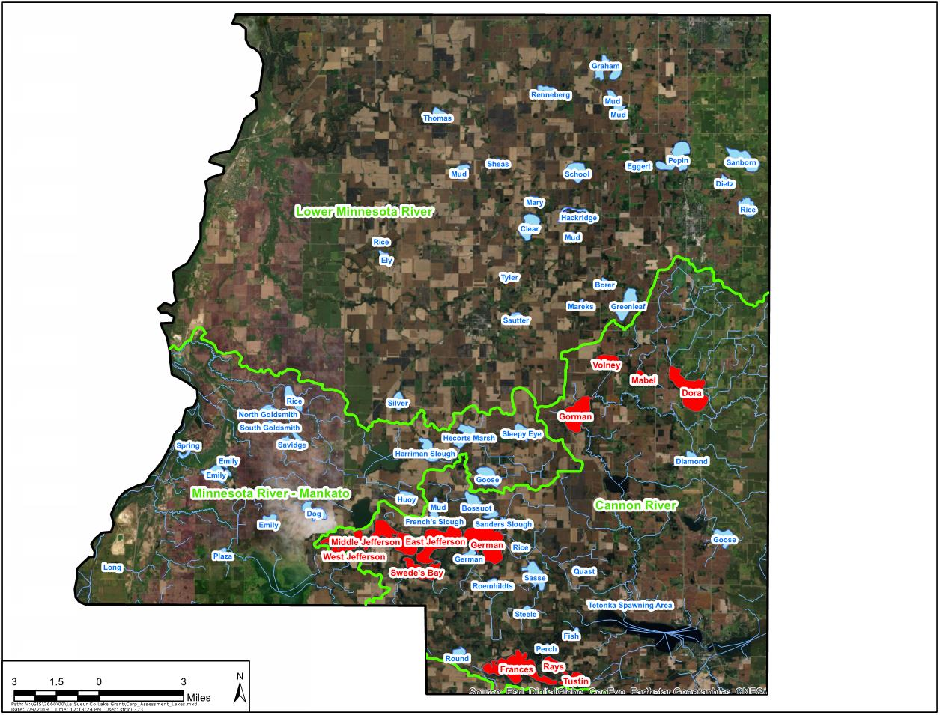
2019 Carp Population Assessments

Slide 16
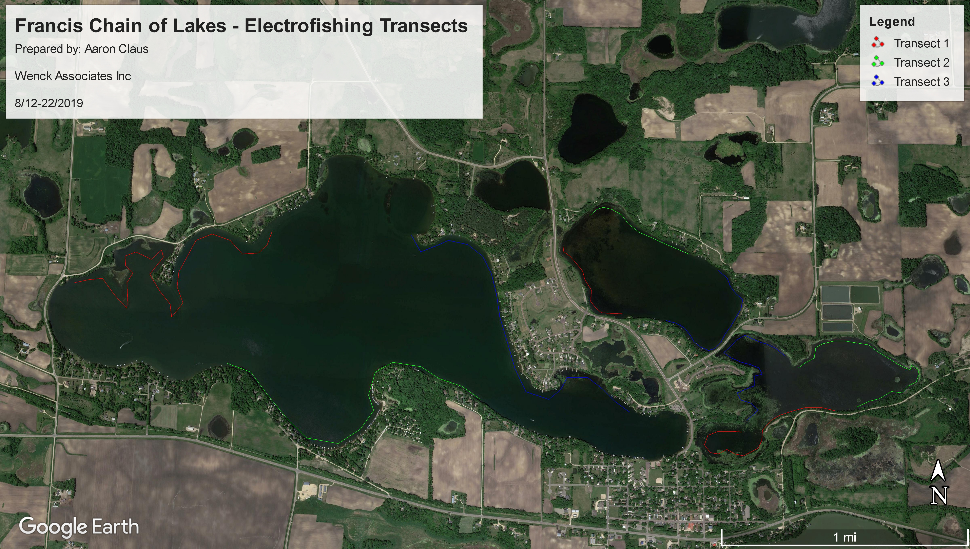

Slide 17
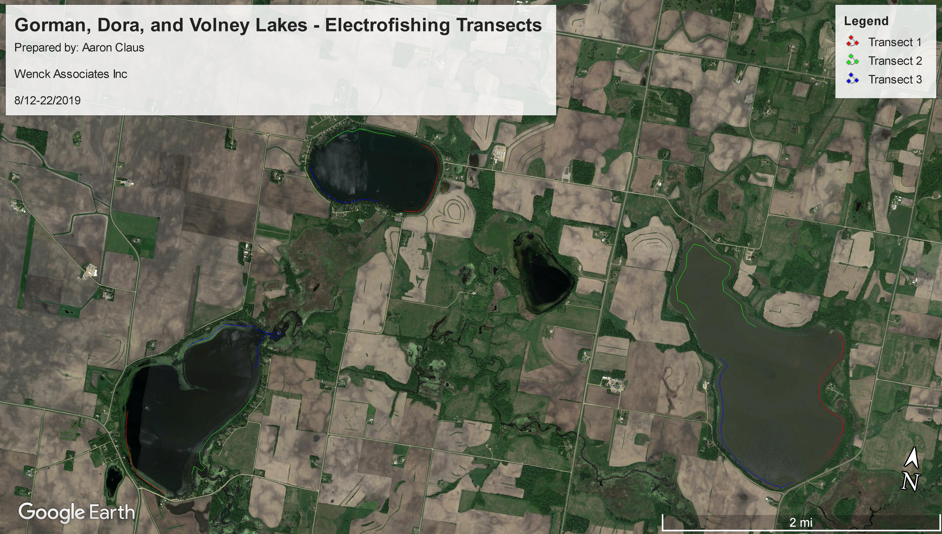

Slide 18
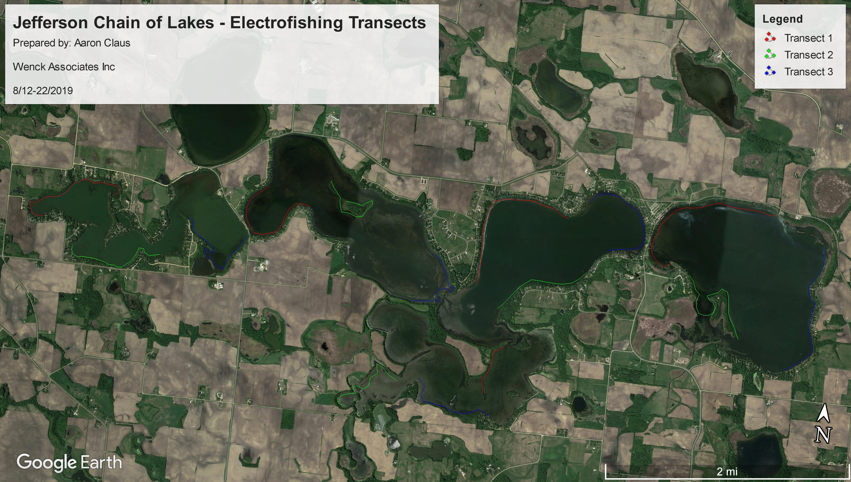

Slide 19
Results

Slide 20
REsults

Slide 21
Carp Assessment Conclusions
Carp populations are very abundant and dense in most Le Sueur County lakes sampled
Densities exceed impairment threshold
Strong effects on ecosystem, game fish, waterfowl
Populations likely functioning at watershed scale
Ray’s lake is a source of carp

Slide 22
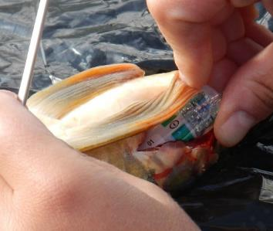
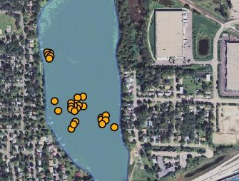
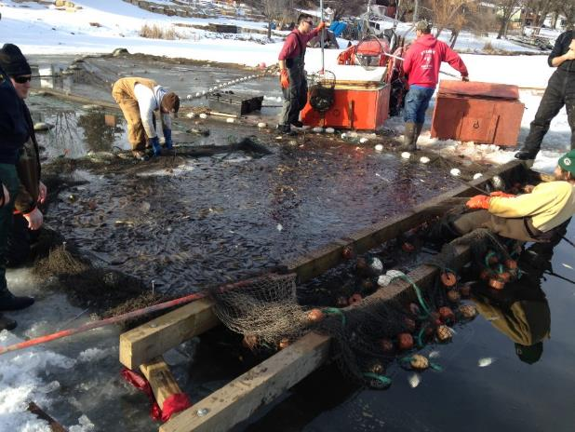
Management Approach
Is there an issue?
Initial Population Assessment
If so, exactly how severe is the issue?
Focused Population Assessment
How can the problem be mitigated?
Control Carp Movement and Reproduction
Adult Carp Removal
How can we prevent from reoccurring?
Maintenance removal
Enhance natural biocontrol
Holistic lake management

Slide 23
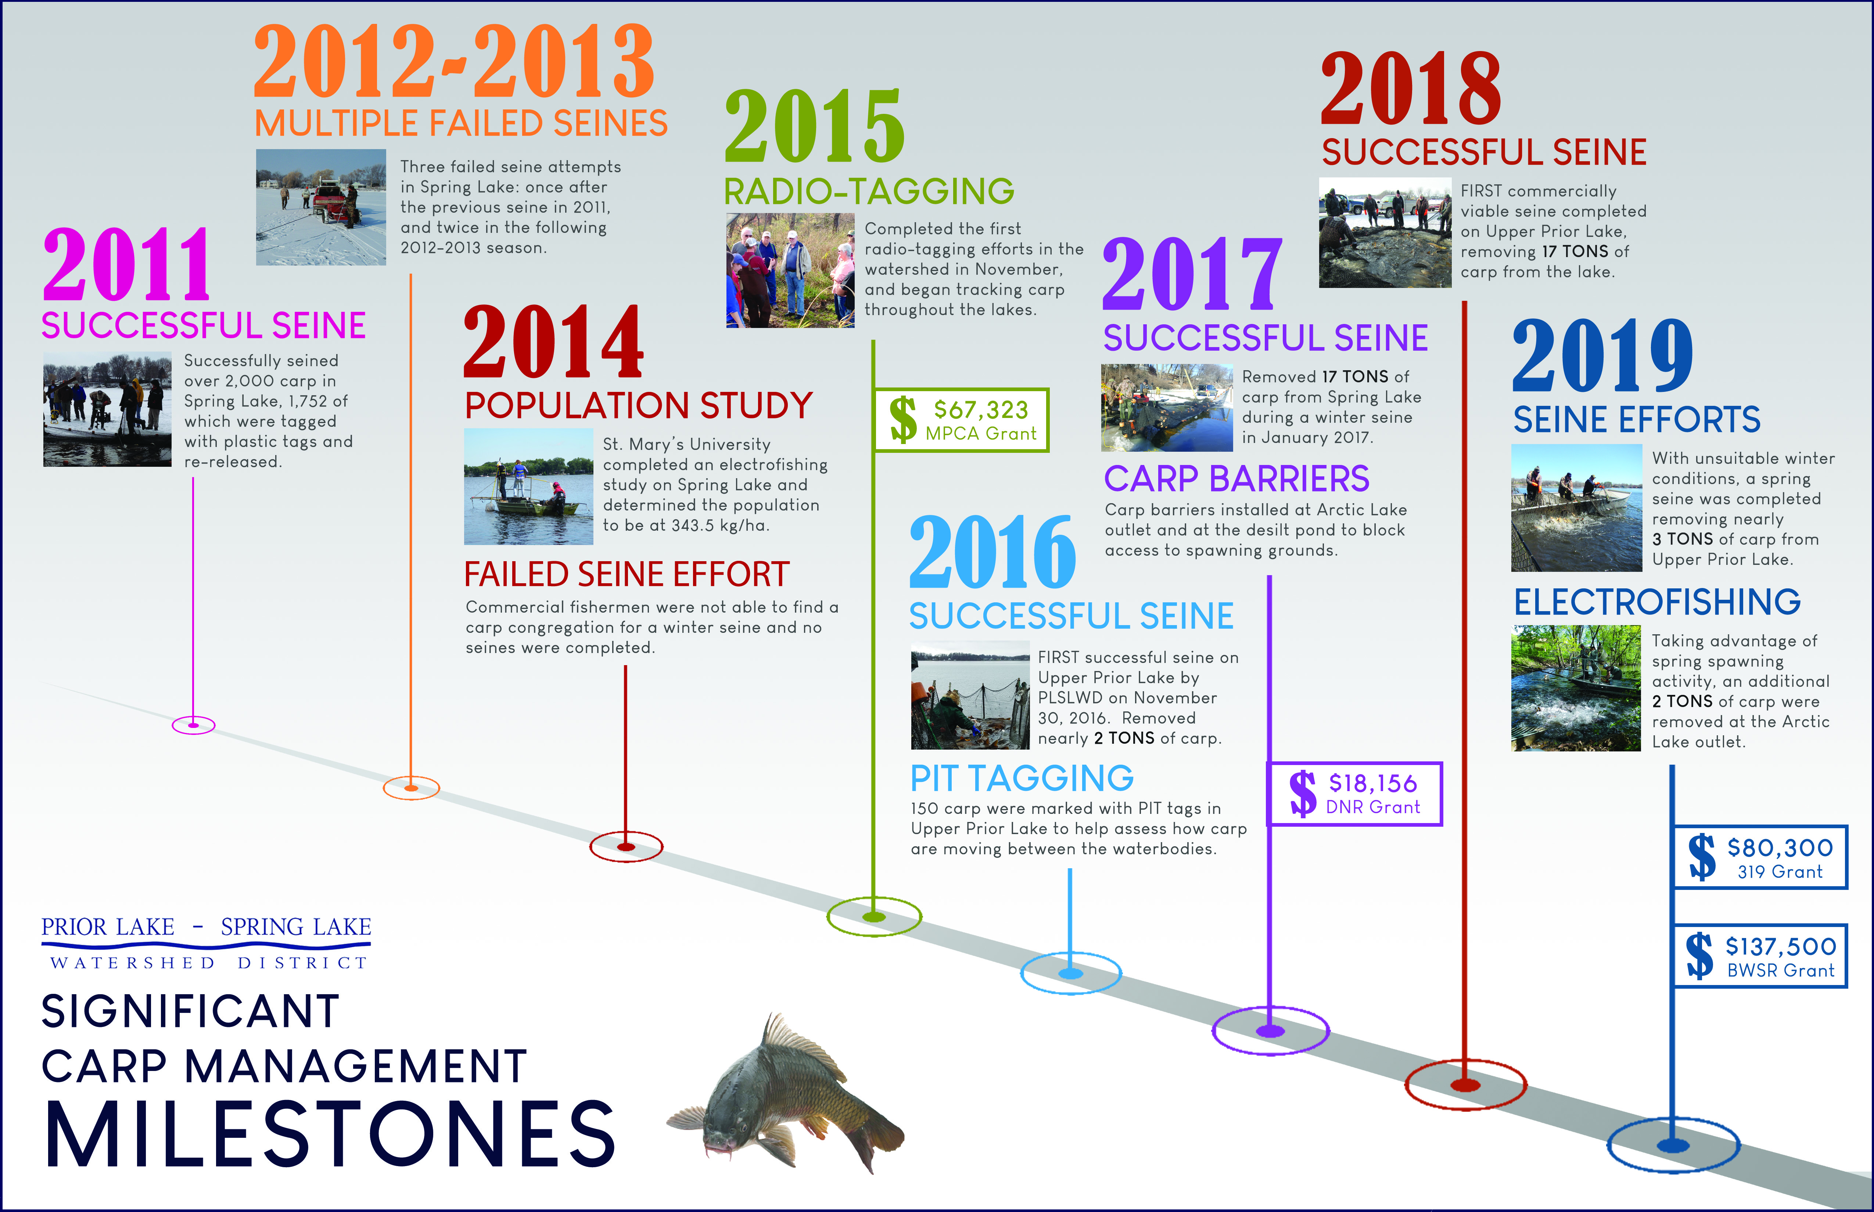
Management Case Study

